Slide 1
Biohackathon Updates
bh2018paris - Day 5 – November 16
Notes:
21 not presenting as 1 day Hack
28

Slide 2

01-OmicsPath
3 bullet points recap aims (current participants No 1 and duration 4 days)
Data import from reactome database and convert to omicsdi format ✔︎
Pathway Analyzer Using Molecules ✔︎
Similar Pathways for Each Datasets (In Progress)
describe achievement so far
Data stored into required similarity format for few set of datasets as test
will your objectives be completed at the end of BH, if not when ?
80 % completed , need more time for data download and similarity processing, probably by next week
Any next steps /followup up from BH planned ?
data similarity matrices calculation after data downloads

Slide 3
02-CompactIdentifiers
3 bullet points recap aims (current participants No and duration )
Run your own Identifiers.org Metaresolver ✔︎
Access Identifiers.org new Cloud API via cloud-libapi ✔︎
Contribute to the development of IdentifiersJS library ?
describe achievement so far
From the aims to metadata mining, machine learning and semantic web
will your objectives be completed at the end of BH, if not when ?
Not only completed but also new paths walked and doors opened
Any next steps /followup up from BH planned ?
Machine learning and semantic web

Slide 4
03-BioTools-EDAM
recap aims
make bio.tools curation more sustainable
better UI for editing bio.tools content
achievement
revised pubmedApps utility for automatic tool metadata generation from parsing the literature https://github.com/edamontology/edammap/tree/master/pubmedapps
revision of new ToolAnnotator http://people.binf.ku.dk/vzn529/eta/
will your objectives be completed at the end of BH, if not when ?
great progress made in all areas
Any next steps /followup up from BH planned ?
put pubMedApps into the bio.tools content production process
finish documenting the revision of Bioschemas Tool profile (with 24 and 11, almost done)
begin implementing new bio.tools content management architecture & local bio.tools deployments from GitHub
revise EDAM Formats & bio.tools using the data we generated
etc.

Slide 5

04-BioJS
Goals
Add example visualisations back on registry website
Revive education/tutorial site
Work towards Galaxy integration/component interoperability
describe achievement so far
BioJS education / training website up & running - http://edu.biojs.net/
Extensible biojs component quality checker - checks for readme docs, examples, links to build packages, etc.
Example visualisations running in some cases. Error messages if not.
will your objectives be completed at the end of BH, if not when ?
Any next steps/follow-up from BH planned ?
BH Japan.

Slide 6
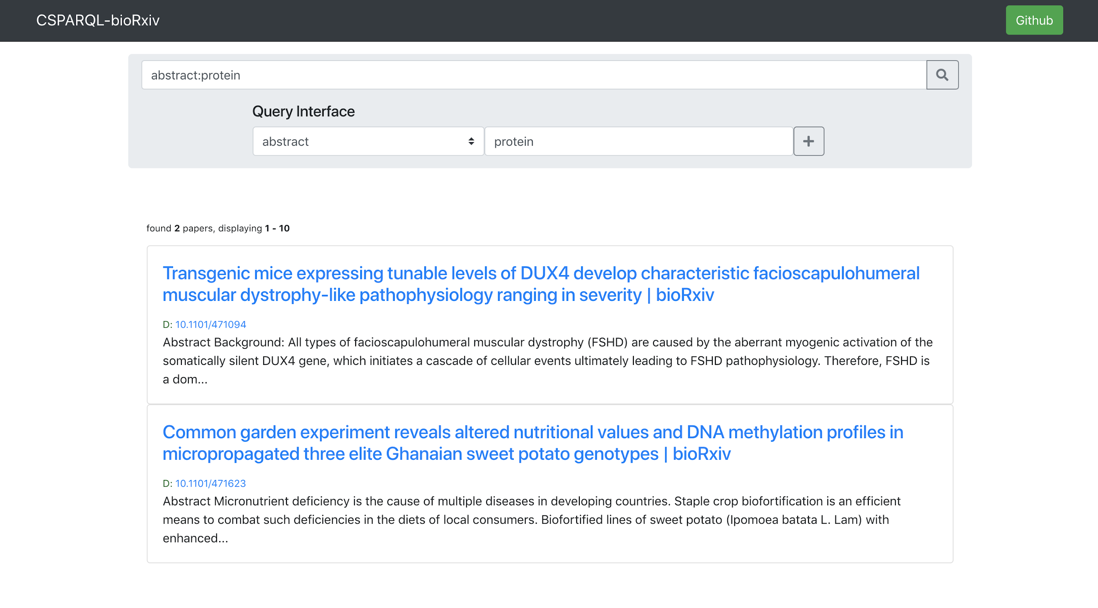
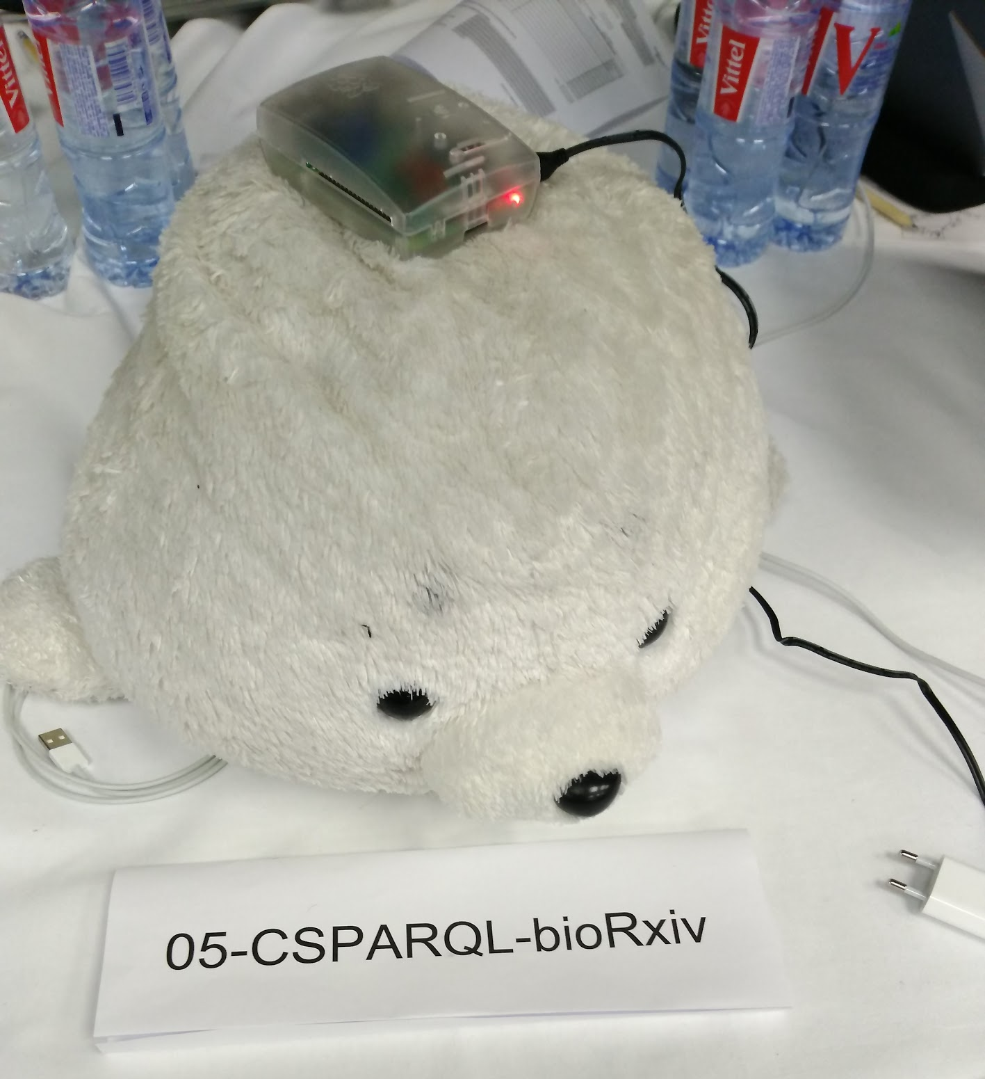
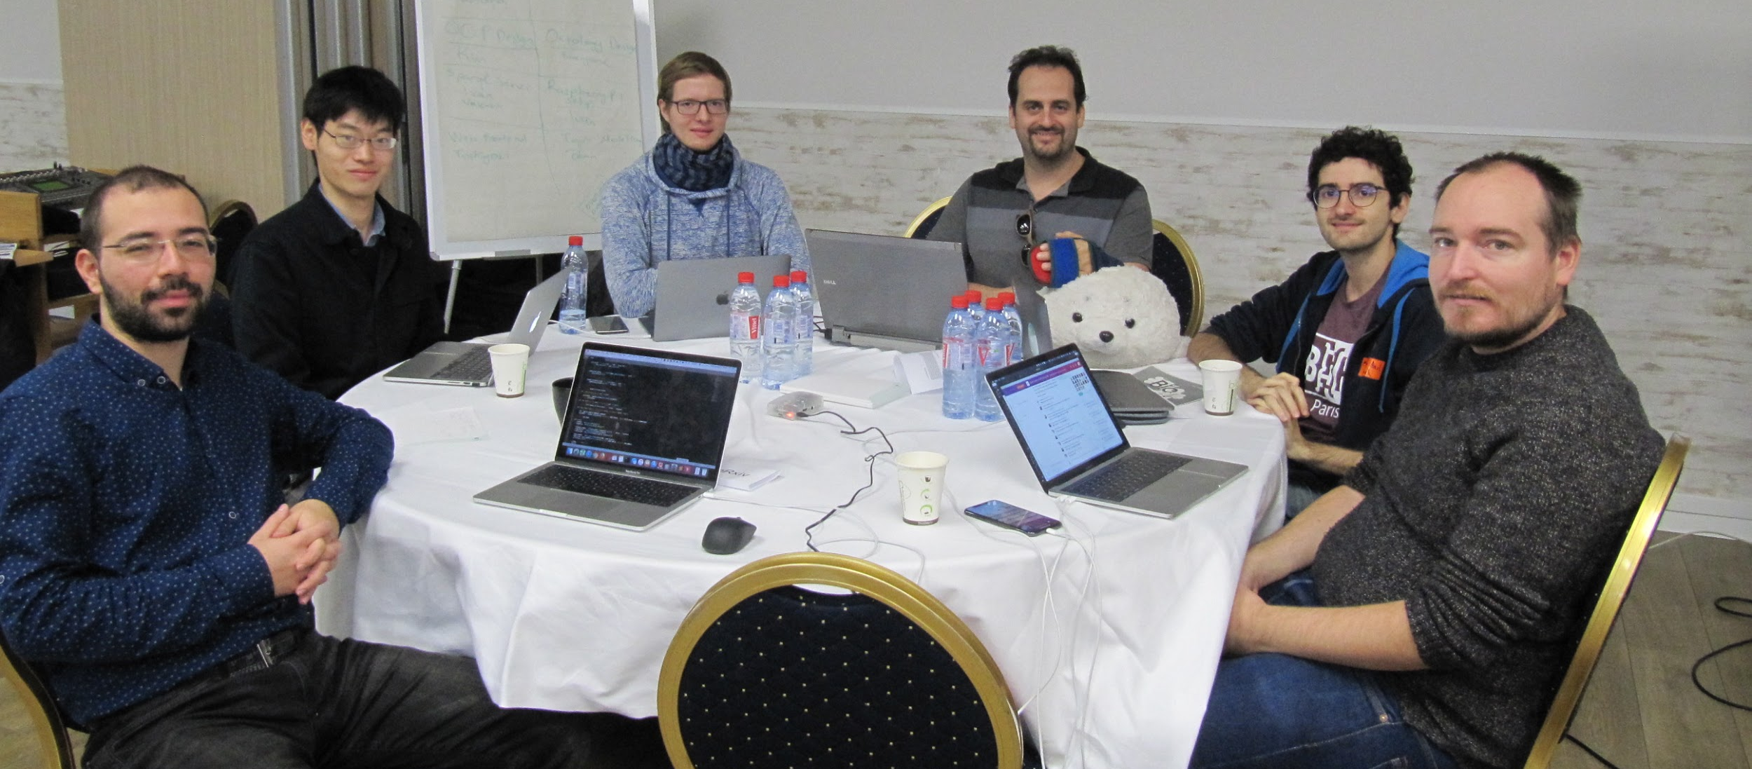
05-CSPARQL-bioRxiv
Goals
Your survival toolkit in the modern avalanche of publications.
Process streaming data from twitter feed to provide real-time publication notifications to users with a sparql compatible web interface.✔
Extract semantic features (e.g. topics) and combine them with ontologies such as EDAM, Biotea. ✔︎
Describe achievement so far
Twitter-feed parsing for live ontology updates
Semantic classifications (as modular plugins) for publications
Gorgeous web interface with querying system
Will your objectives be completed at the end of BH, if not when ?
Notification system and statistical topic modelling are remaining
Any next steps/follow-up from BH planned ?
Notification system
Improve topic modelling
Recommendation system
Notes:
<3

Slide 7
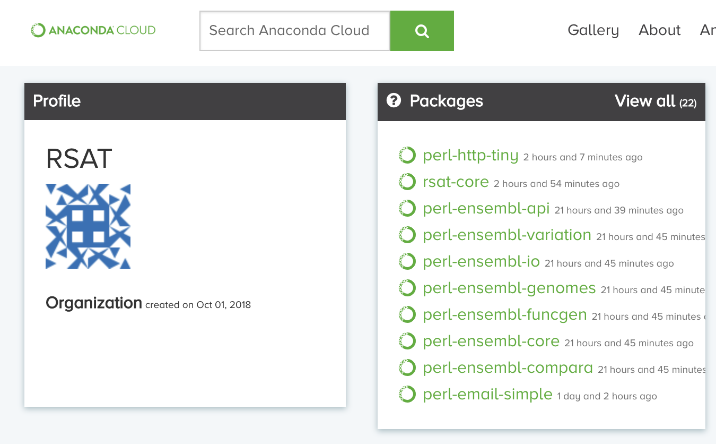

06-Bioconda-RSAT
Initial goals
conda install -c bioconda rsat-core
conda install -c bioconda rsat-data
conda install -c bioconda rsat-web
Current status:
conda install -c bioconda -c conda-forge -c rsat rsat-core
describe achievement so far
will your objectives be completed at the end of BH, if not when ?
Any next steps /followup up from BH planned ?

Slide 8
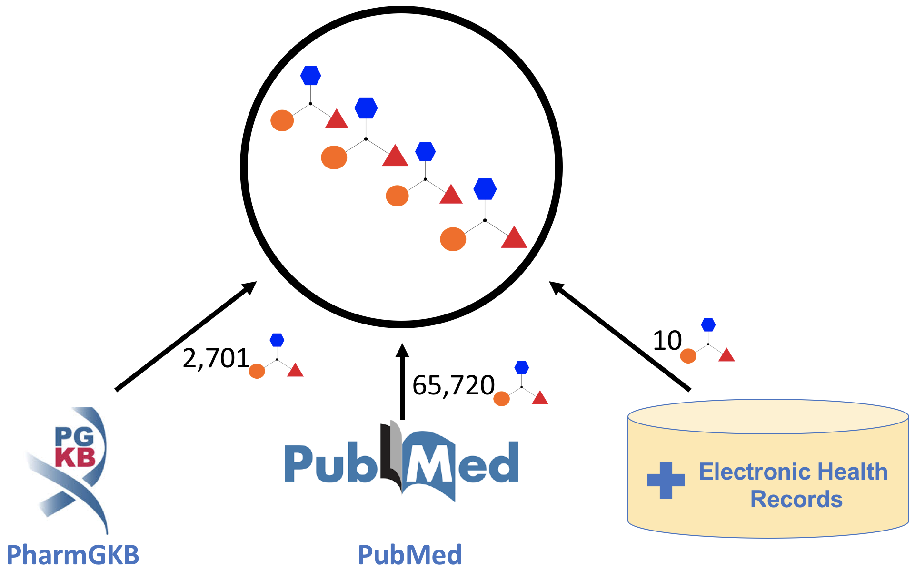
07-Pharmacogenomic LOD (PGxLOD)
Aims (recap)
1/ Improve PGxLOD (4 persons)
2/ Explore PGxLOD for ADR explanations (4 persons)
3/ Develop an observational PGxLOD (2 persons)
describe achievement so far
Updated extractors and normalization system
One first (fake) patient to the data
One training set (sparse matrix)
will your objectives be completed at the end of BH, if not when ?
partially, but we had a lot
Any next steps /followup up from BH planned ?
next week: Podium abstract for MedInfo 2019
early Dec.: PGxLOD v4

Slide 9



08-DataClearinghouse Validation and Curation...
3 bullet points recap aims
Being able to reuse curated resources like MarRef database to curate BioSamples
Export Breeding API data to ISA tab and validate the results against MIAPPE
describe achievement so far
Finished to build proof of concept for Marref API to expose Bioschemas
Validated the Marref BioSchemas against BioSchemas Sample profile and started script to curate BioSamples
Refactor and improvement of BrAPI2ISA tool, part of the ISA API toolsuite : Strong foundation for next remote collaborative development
BrAPI / MIAPPE mapping and ISA configuration to be used for validation
will your objectives be completed at the end of BH, if not when ?
MAR: Still need to finish proof of concept curation pipeline - in a couple of days
Plant : Still some validations and extension to handle all use cases on the BrAPI 2 ISA tool. Encapsulation as a web service.
Any next steps /followup up from BH planned ?
BioSamples and Marref to collaborate for data exchange and possibly work on the DataClearinghouse
Plant:
Collaborative development on BrAPI2ISA including BrAPI Hackathon in WUR (www.brapi.org)
BrAPI2ISA as a web service and BrAPPS
Validation on private datasets
Manuscript

Slide 10
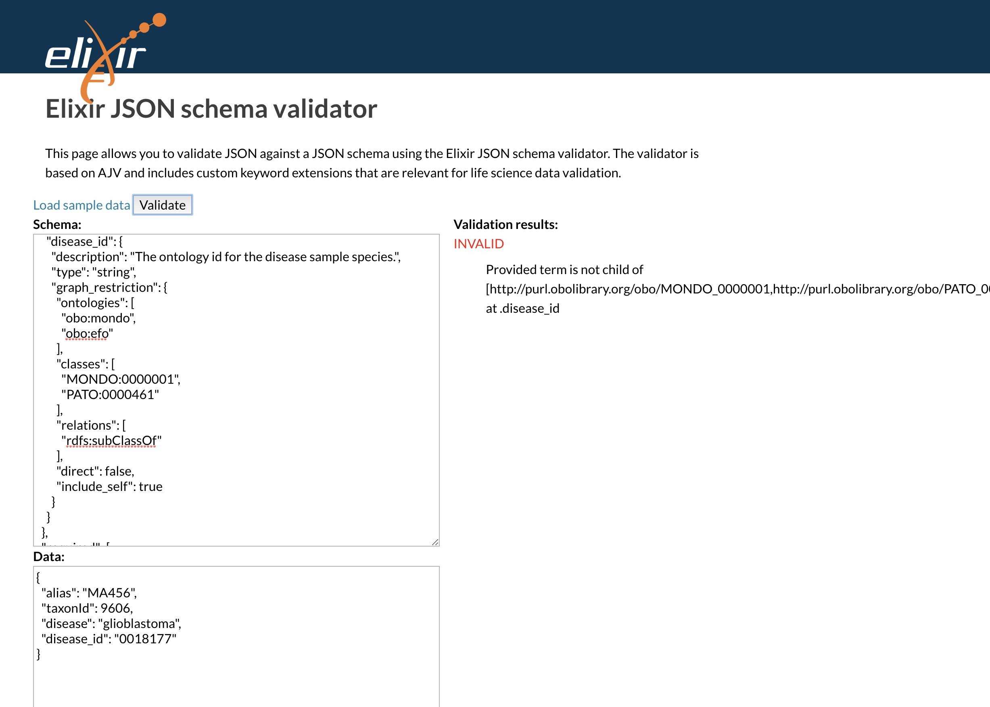
09-OntologyValidation
"graph_restriction": {
"ontologies": [
"obo:mondo",
"obo:efo"
],
"classes": [
"MONDO:0000001",
"PATO:0000461"
],
"relations": [
"rdfs:subClassOf"
],
"direct": false,
"include_self": true
}
Task
Implement ontology term validation extensions to AJV
Source code https://github.com/elixir-europe/json-schema-validator
Package in NPM https://www.npmjs.com/package/elixir-jsonschema-validator
Docker image https://hub.docker.com/r/ebispot/elixir-jsonschema-validator
will your objectives be completed at the end of BH, if not when ?
Yes
Any next steps /follow up up from BH planned ?
Deploy in EBI submissions systems and Human Cell Atlas

Slide 11


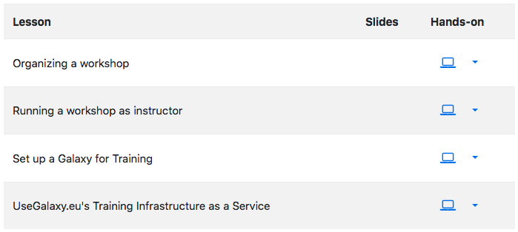
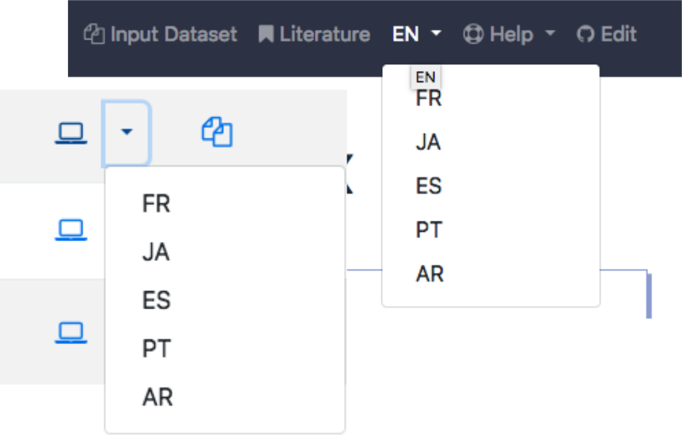
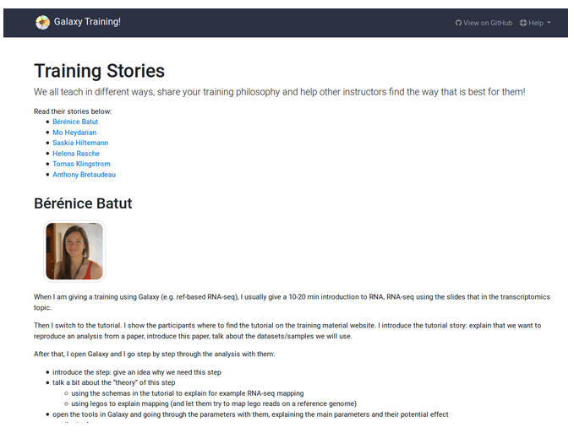
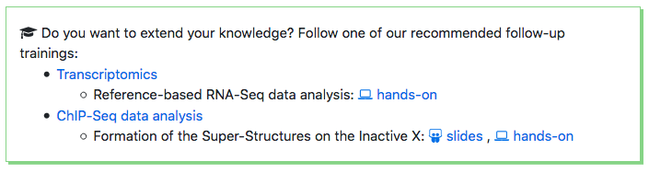
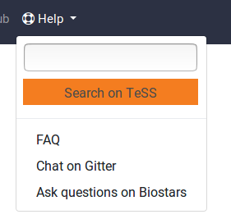
10-Galaxy Training Material
Aims (3 participants, more online, everybody welcome)
Content creation and improvement
Other achievements
2 submitted grant proposals
FAIRness assessments
Community expansion
✓ Training Handbook and Philosophie
✓ Internationalization/localisation
Curriculum
Search on TeSS

Slide 12

11-Bioschemas
Recap of aims (three tables, 30+ people)
Marked up resources
Create/Refine profiles: Gene, Protein, Studies, DNA, Molecular Entity, Chemical Substance, ...
Develop support tools
Create types/profiles for the refined hierarchy
describe achievement so far
will your objectives be completed at the end of BH, if not when ?
Any next steps /followup up from BH planned ?

Slide 13

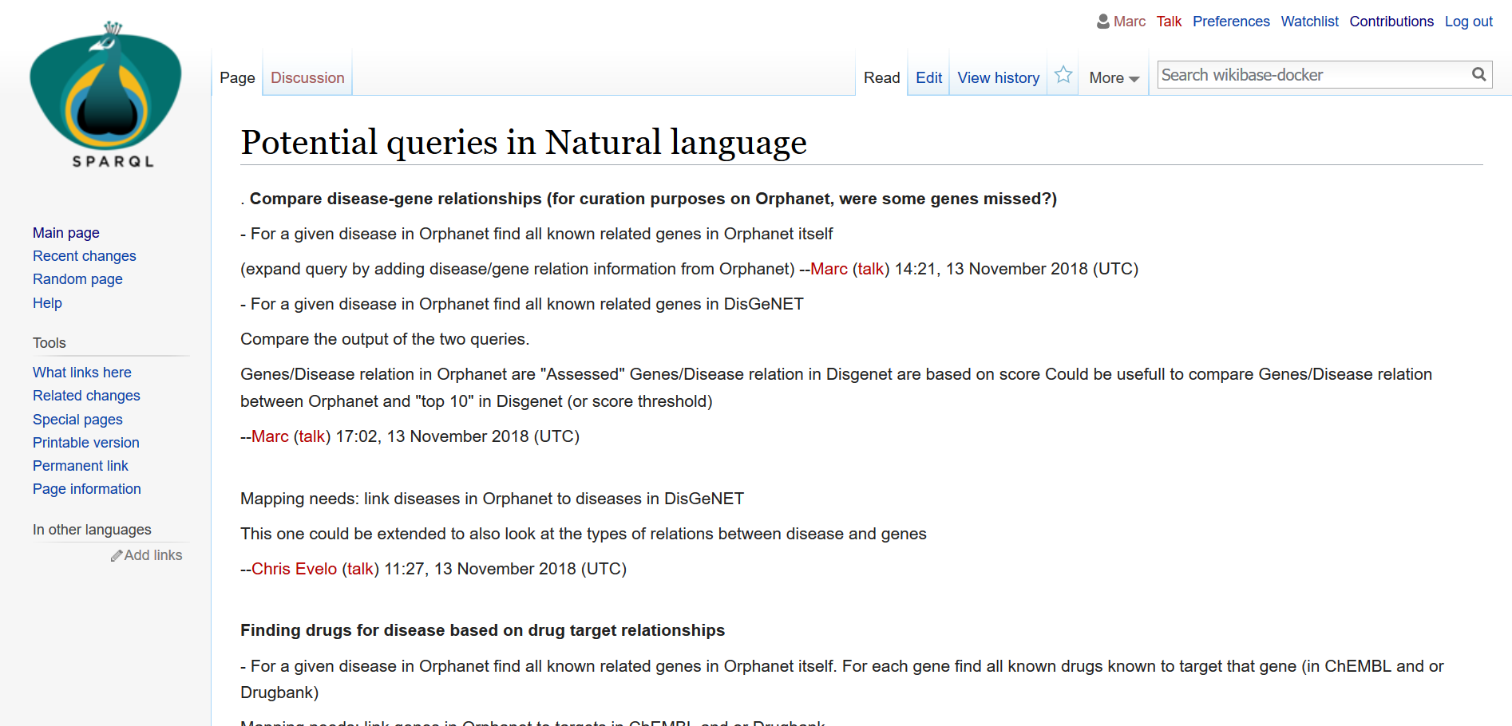
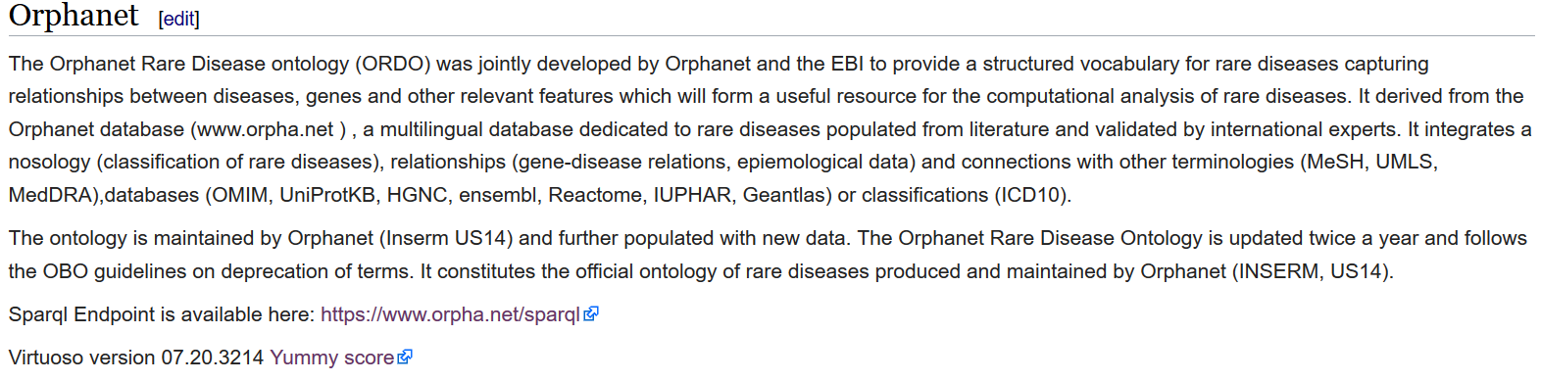
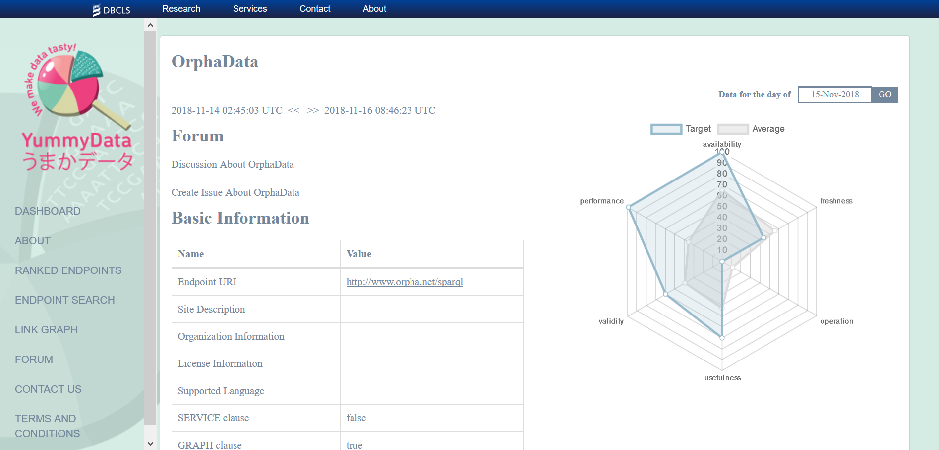
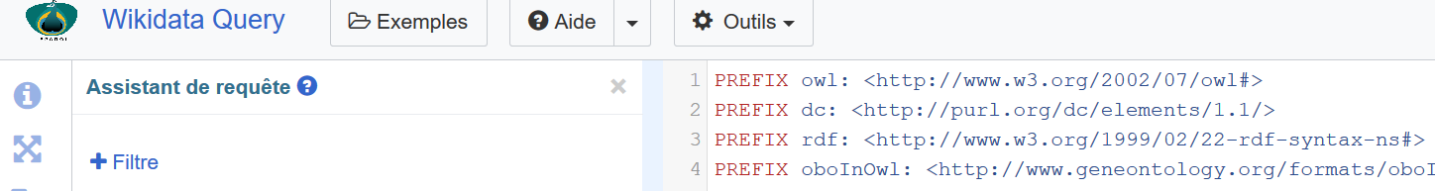
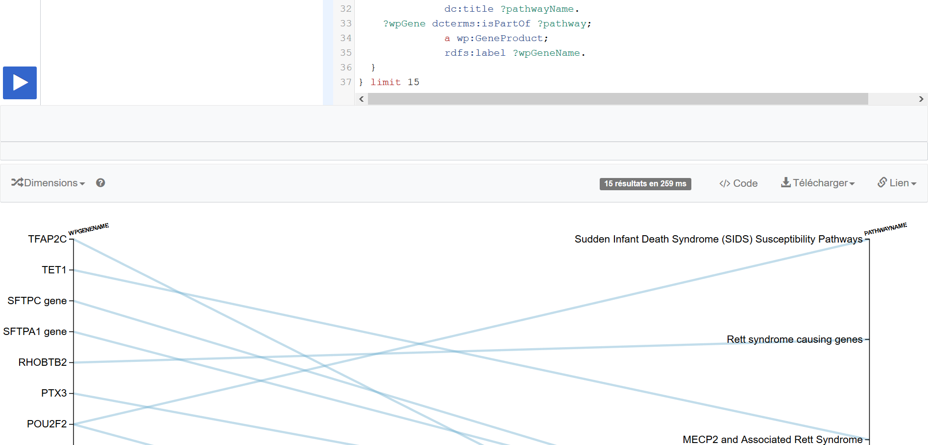
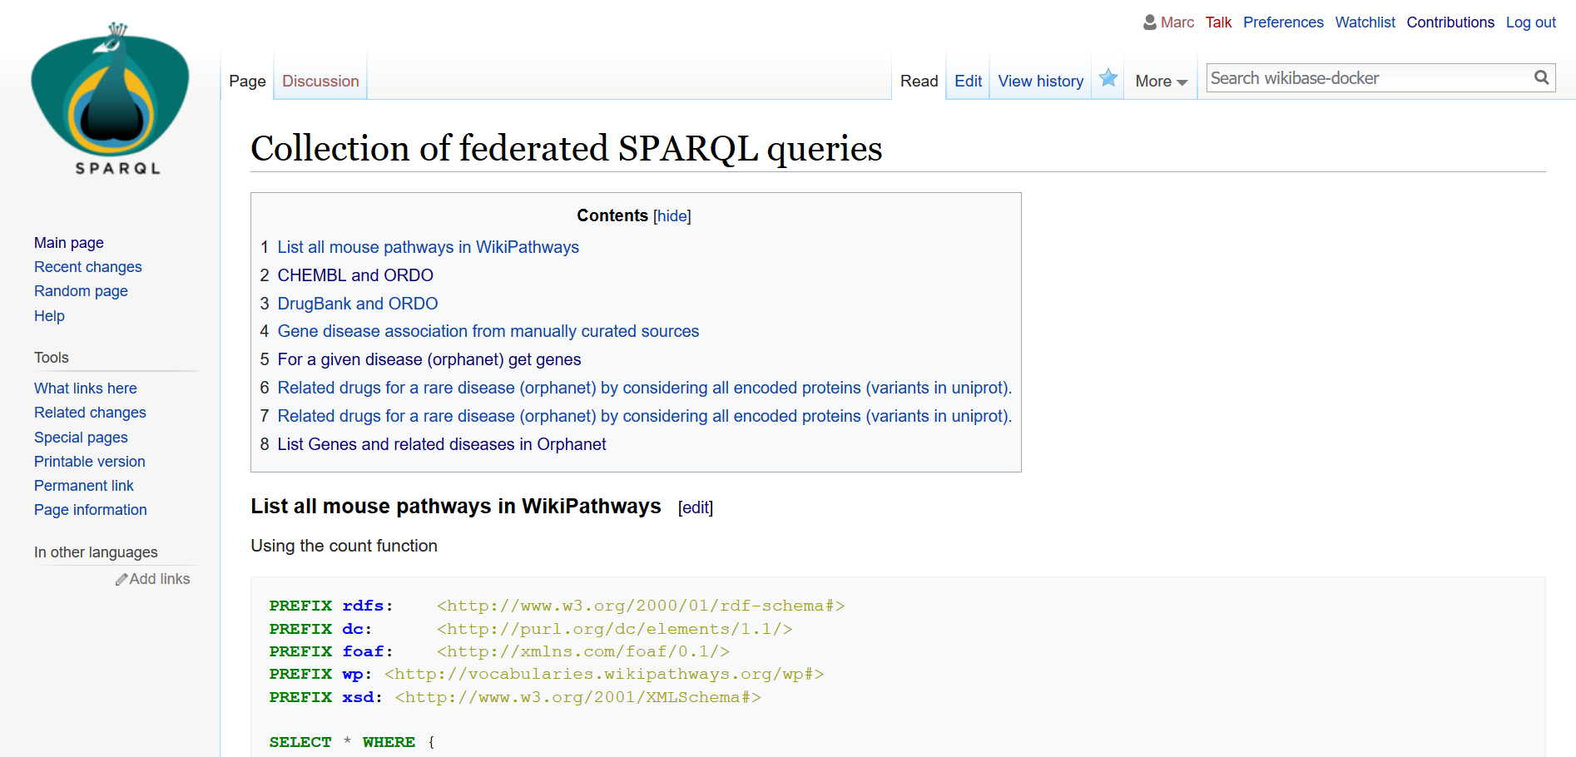
13-SPARQL-RareDiseases
THe Peacock SPARQL system runs at : http://185.54.113.31:8181/wiki/Main_Page
It contains description of 5 endpoints (Wikidata, Orphanet, Disgenet, WikiPathways and UniProt)
It contains sparql queries examples across different resources
Request can be run at http://185.54.113.31:8282
TODO: deploy the changes that were made to Wikibase to create Peacock docker

Slide 14


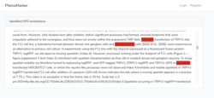
14-Orphanet-PhenoScrapper
Project aims (David Salgado - Toyofumi Fujiwara - David Lagorce)
Speed-up the process of Orphanet disease-HPO annotation and improve curation process
describe achievement so far
will your objectives be completed at the end of BH, if not when ?
75% completed !
Any next steps /followup up from BH planned ?
Add others interactive taggers / scrapping tools
Create system to increase user interaction with text and labels
Add exporting procedure
PhenoMarker
Text File

Slide 15
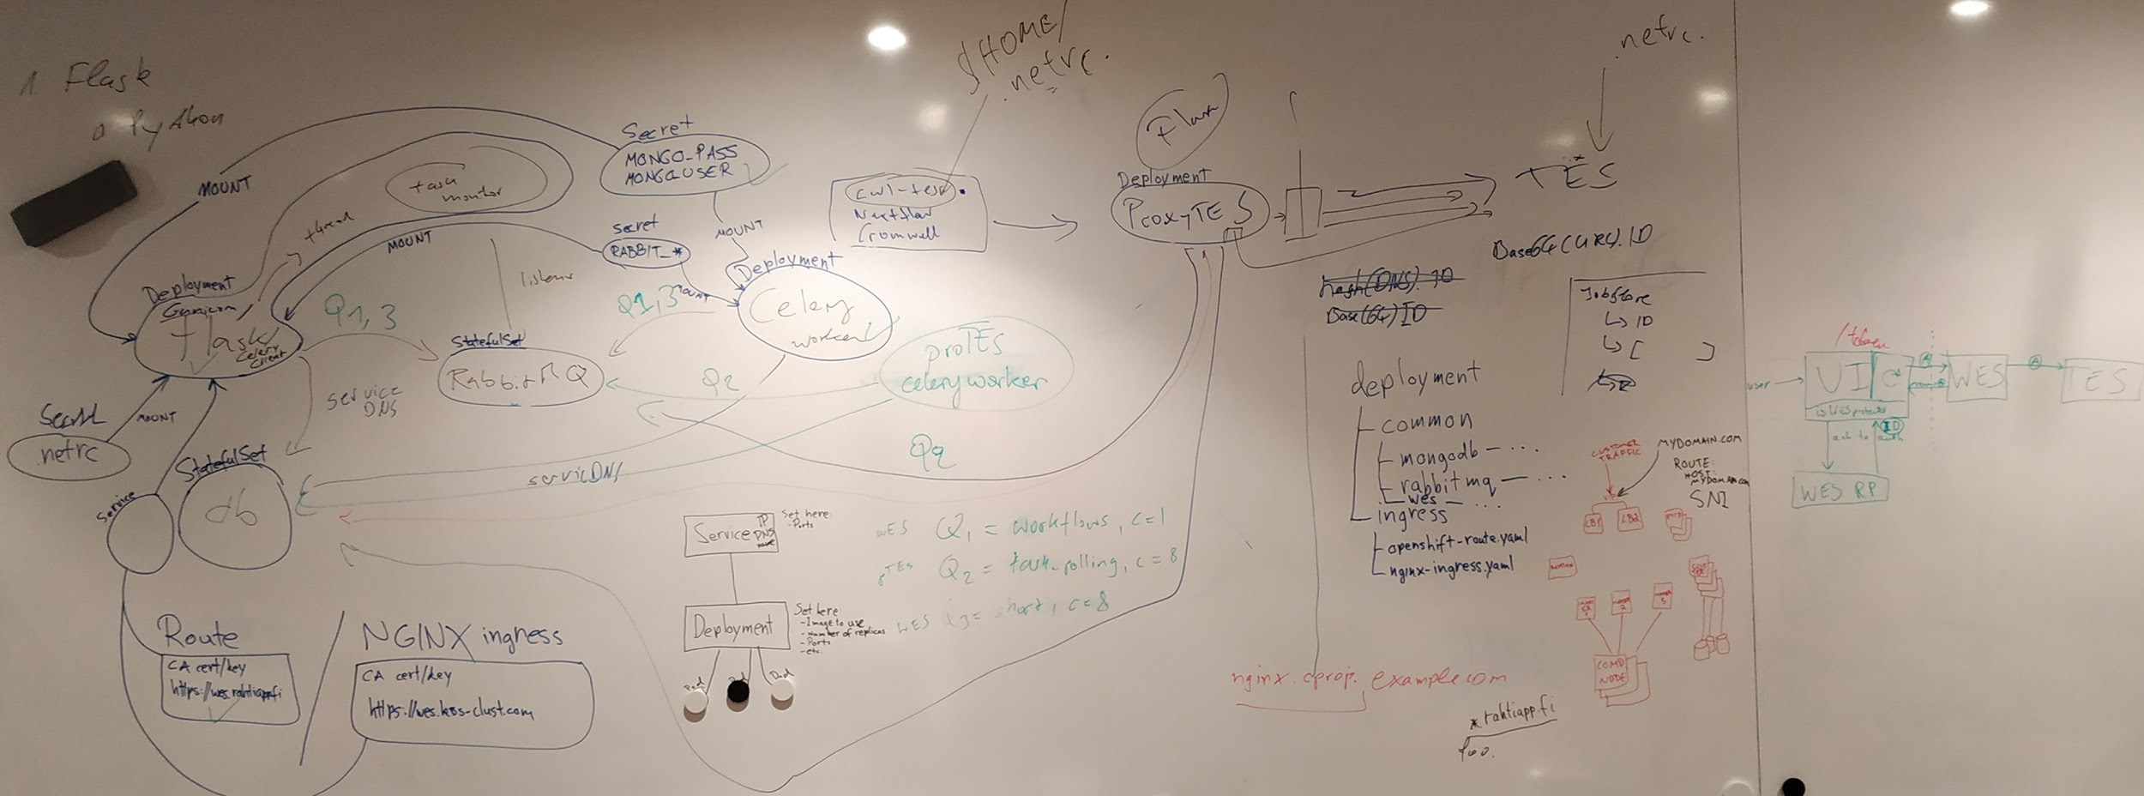
15-GA4GH-WES
Aims
(A) Pluggable workflow engines (B) Task distribution
(C) Authorization & authentication (D) Production-grade deployment
Achievements
(General) Involved more people in the project with expertise that we did not have before
(General) Improved the design architecture of the application
(A) Proxy TES skeleton with some functional endpoints; not yet integrated with main WES app
(B) Rudimentary task distribution logic implemented
(B) Git repository: https://github.com/elixir-europe/TEStribute
(C) Implemented UI service with OIDC-based authentication
(C) Implemented access token flow (UI -> WES -> TES) & validation
(C) UI token endpoint can be used to refresh expired tokens
(D) App deployed in Kubernetes
(D) Service running on: https://wes-test.c03.k8s-popup.csc.fi/ga4gh/wes/v1/ui/
Any next steps /follow-up up from BH planned ?
Fully spec-compliant v1.0 planned for end of 2018

Slide 16
16-Alternative episodes for the 4 Open Source Software (4OSS)
Participants
Fotis, Mateusz, Paula, Victoria, Denise, Jen, Allegra
https://github.com/SoftDev4Research/4OSS-lesson
describe achievement so far
We have completed the topics planned to be added during the hackathon
14 PR’s merged
1 episode fully reviewed, 1 mostly reviewed, 2 sections added and reviewed
We planned some workshops and presentations for next year!
We are inviting people to share when they use the lesson
will your objectives be completed at the end of BH ?
Yes! our follow up plans are to continue the review. Connect this lesson with Life science Open Software metrics.
We will publish the first lesson in zenodo in 4 weeks.

Slide 17
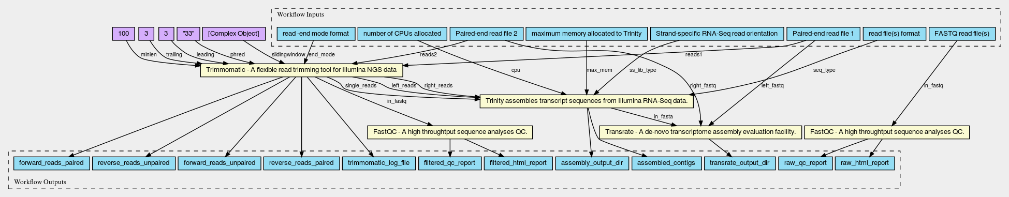

17-CWL-Galaxy
Participants: Michael R. Crusoe, Manabu Ishii, Stian Soiland-Reyes, John Chilton, Nicola Soranzo, Arnaud Meng, Hervé Ménager, Pau Ruiz Safont, Pjotr Prins, François Moreews, Jérôme Raciazek
Achievements
CWL support modifications are now in the same repository
All mandatory CWL conformance tests are now passing!
Corrections to the Marine Metagenomics Workflows
Added Python 3.7 support to Galaxy
Created Repository for CWL GUI Workshop and slide for workshop
Galaxy-CWL support is a long term project, but we’ve made real progress this week!

Slide 18
18-PSICQUIC_2.0
4 bullet points recap aims (Noemi del Toro, John Zobolas, Elisabet Barrera)
myPsicquic
PSICQUIC Cluster
PSICQUIC Extensions
PSICQUIC View
describe achievement so far
New PSICQUIC View project with Angular (done)
Advanced search component integration (done)
Parsing json output from jquery queryBuilder to solr query (in progress)
Extension of PSICQUIC with the new miTab 2.8 (almost done)
Conversation to integrate identifiers.org
will your objectives be completed at the end of BH, if not when ?
No, but it was expected due to the scope of the proposal
Any next steps /follow up from BH planned ?
We will continue working in the rest of the topics in our home institutions.

Slide 19
19-MetagenomicsMetadata
Project finished yesterday, no new progress required

Slide 20
20-Shiny-RStudio-Galaxy
HIDDEN Slide: Our hack was only for 2 days.
will your objectives be completed at the end of BH, if not when ?
Some were completed, some where not. The docker volume plugin reaches an alpha stage, the shiny improvements were not able to be implemented
Any next steps /followup up from BH planned ?
We will deploy the docker galaxy fuse volume and test this in production
We will continue to improve the shiny IEs with the new filesystem

Slide 21
21-FAIR-TrainingMaterials
Aims
Discussion: What is a training material, what does FAIR mean for training materials
Assessed some training with FAIRNESS matrix → Elixir Train the trainer & Galaxy, [working on] Jupyter Notebooks
Comprehensive list of metadata for training materials
Redistribution of properties to better align with schema.org and Bioschemas training group profile
Bioschemas specification creation for Course, CourseInstance and TrainingMaterial, [on working] validate with Goblet
Will your objectives be completed at the end of BH, if not when ?
No yet, this is a working group (starti)
Any next steps /followup up from BH planned ?
Working group, paper on preaparation and meetings once a month

Slide 22
22-FAIRDOM-SEEK-ResearchAssets
3 bullet points recap aims (current participants No and duration )
Exchanging assets between SEEKs
Galaxy integration
Incorporating Bioschemas
describe achievement so far
will your objectives be completed at the end of BH, if not when ?
Any next steps /followup up from BH planned ?

Slide 23
23-RDF-ModelsAndTools
3 bullet points recap aims (current participants No and duration)
Complete the Identifiers.org Ontology and Human Chromosome Ontology
Update Biomedical RDF data, Update BioSamples data model
Collaboration of TogoStanza and BioJS
describe achievement so far
Completed Identifiers.org OWL and released in JSON-LD format
Completed ICGC RDF compliant with the Med2RDF data model
Aligned models between DDBJ/EBI BioSamples (Thanks to the EBI and Bioschemas teams!)
Found advantages in TogoStanza and BioJS, discussed about compatibility and future work
will your objectives be completed at the end of BH, if not when ?
Yes for Id.org, SPARQL Builder, ICGC ; Not yet for some others (we had too many objectives;)
Any next steps /follow up from BH planned ?
We had very good collaborations. Continue the work in Matsue, Japan :)

Slide 24

24-ToolsMetadata
https://github.com/elixir-europe/BioHackathon/tree/master/interoperability/Putting structured data into individual entry pages in biological database
Project aims (4 participants )
To markup pages of biological databases and tools
To make rich snippets of biological databases and tools in search results
describe achievement so far
Surveyed some markup schemas for biological tools (e.g. bio.tools, bioschema, schema.org, Google structured data)
Discussed about good schema on search result with 03-BioTools-EDAM.
Made a draft schema, scripts to markup HTML and a mockup search result page.
will your objectives be completed at the end of BH, if not when ?
Almost completed
Any next steps /followup up from BH planned ?
Get tool info via bio.tools API / RDF
Improve our Life Science Cross Search to show tool info with rich snippets
Improve to show database info
<LINK>
<LINK>
<LINK>
<LINK>
<LINK>

Slide 25
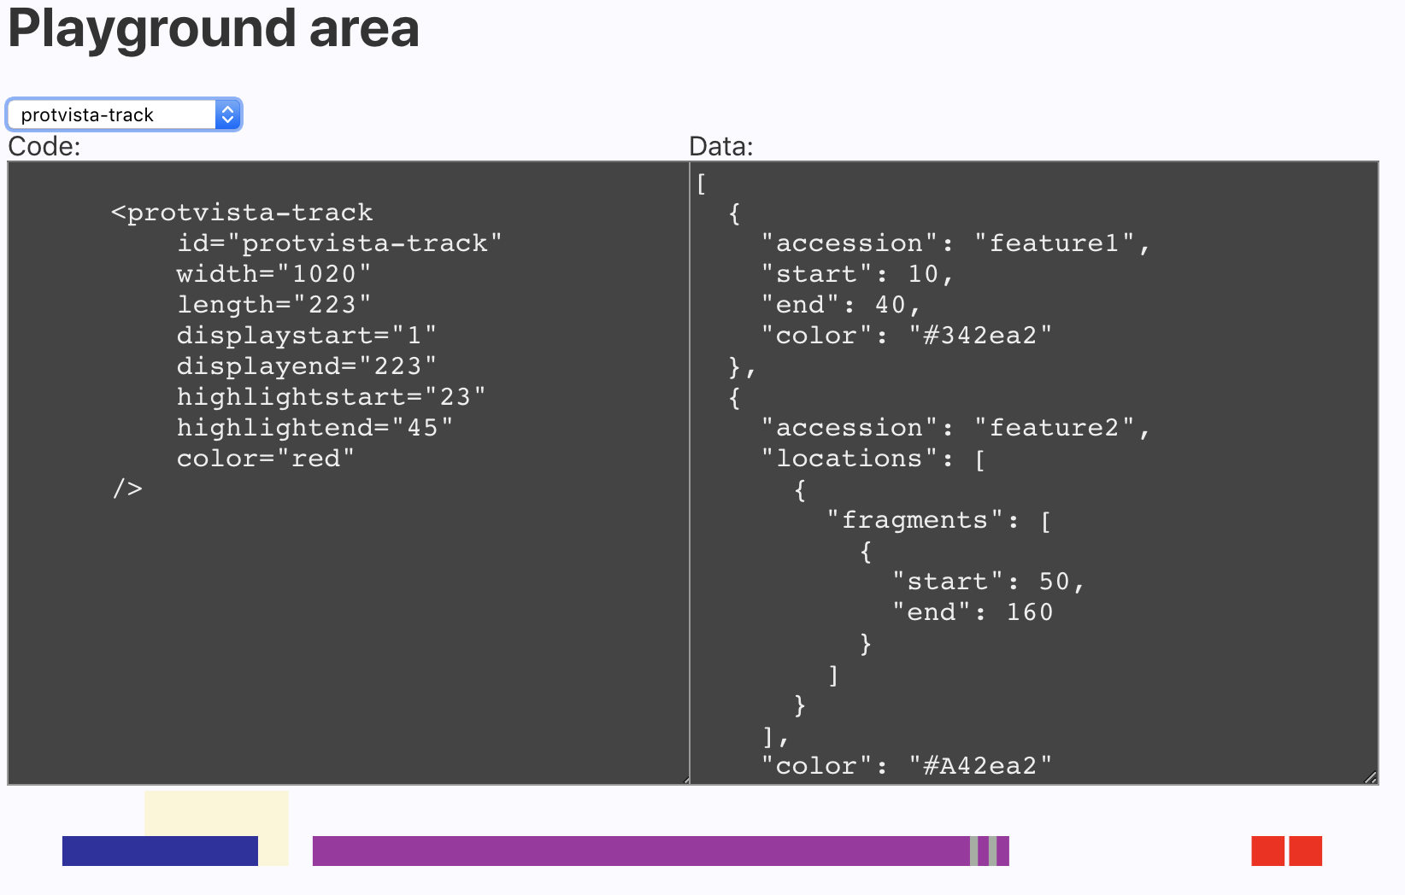
25-ProtVista-Bioschemas
3 bullet points recap aims (current participants No and duration )
👍🏽To define a way to represent protein domains with bioschemas
👎🏽To take this info from a website, and represented with Nightingale
describe achievement so far
PR for Playground Area For NIghtingale
will your objectives be completed at the end of BH, if not when ?
Next week I’ll update the JSON-LD for the InterPro pages https://www.ebi.ac.uk/interpro/beta/

Slide 26
26-Blockchain-TrackingBioSamples
3 bullet points recap aims (current participants No and duration )
Federico Lopez, Claus Weiland, Isabelle Perseil, Carlos Castro-Iragorri (4 days).
Use blockchain technology to support provenance and sample supply chain management.
BioSamples as surrogate for other biomedical samples
describe achievement so far
PoC on Hyperledger composer, BioSamples.bna.
Track the curation process (layers) using transaction log and state data.
will your objectives be completed at the end of BH, if not when ?
PoC is complete and documented as use case in blockchain.
Identified added value in sample management: tracking changes in the samples (not decentralisation).
Any next steps /follow up up from BH planned ?
Rebuilt a particular state applying a number of curation layers.

Slide 27
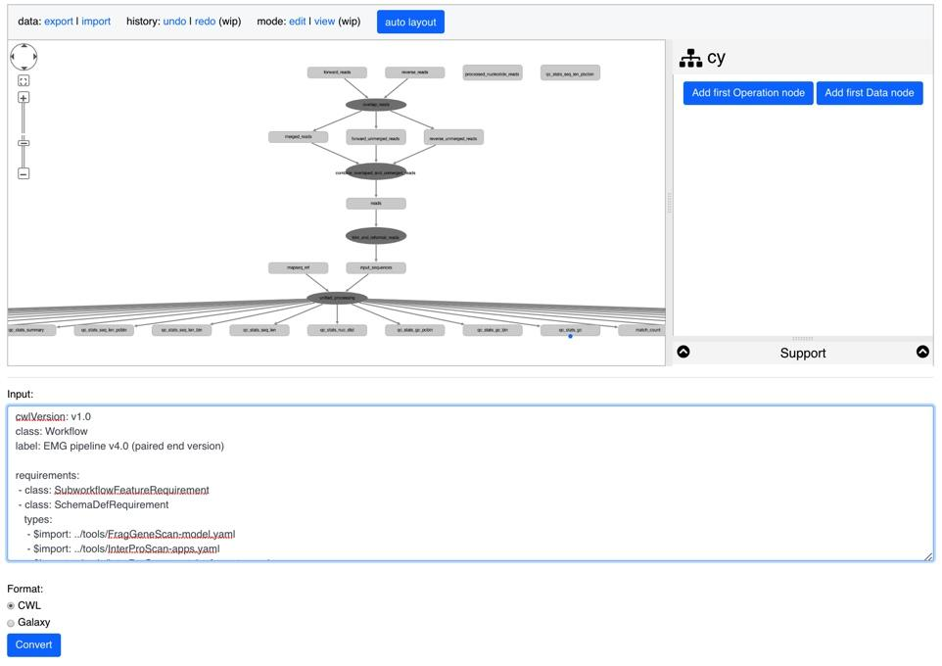
27-TeSS-ConceptMaps
Import Workflows into Concept Maps to make linked, interactive Training Resources!
Concept Maps teach people what the core concepts of typical data analysis pipelines are
The task is to create skeleton Concept Maps by importing Workflows
describe achievement so far
Completed implementation tool for [Galaxy|CWL] to Concept Map!
Any next steps /follow up from BH planned ?
Release everything on TeSS production site
Use GTN Materials to make Concept Maps
Visualize Galaxy workflows from Galaxy Instances
Make Concept Maps for Proteomics Workflows with Veit

Slide 28


28-Biotea-Bioschemas-Publications
→
Aims
Map Biotea model for metadata and references to Bioschemas profiles
Journal, PublicationIssue, PublicationVolume, ScholarlyArticle
Describe achievement so far
Collaboration with other groups
Definition of use cases, crosswalk and specification folders at Bioschemas GDrive
Creation of the group and Journal profile in local branch
Will your objectives be completed at the end of BH, if not when ?
Not at the BH, hopefully by January
Any next steps /followup from BH planned ?
Continue working

Slide 29
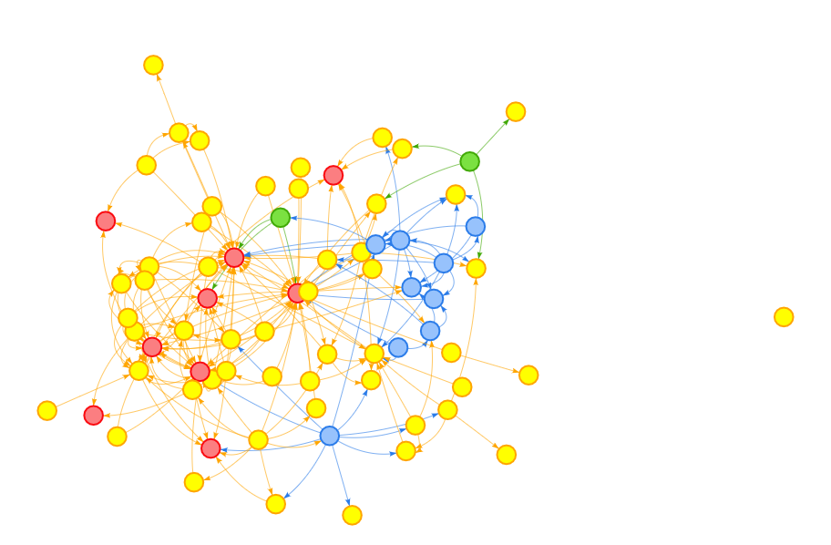
29-ProteinTargets-KnowledgeNetworks
Main aims (current participants 2, duration 4 days )
Create linked/integrated data defining drug, protein target, pathway and phenotype relationships
Providing a better understanding of these data by enabling the interrogation of data via
SQL: all sort of queries
Graph: motif discovery, subgraphs, graph algorithms (connected components, Label propagation, shortest path, etc)
describe achievement so far
Some data collections created
Initial GraphFrame created
Early exploring of graph data has begun with complex queries (motive search, chains, graph algorithms)
will your objectives be completed at the end of BH, if not when ?
No, but we achieved 100% of understand and 60% of coding (we were very ambitious)
Still need to look into ML objectives
Given opportunity have a prototype by end of year (eg if there are no big issues with UniProt)
Any next steps/follow up from BH planned ?
Complete data consumption
Start applying ML for specific objectives (this is related to another project on Alzheimer’s Disease)
Look at establishing a collaboration with Pharmacogenomic LOD (PGxLOD)

